Slide 1
World Of Irises
A tale of color and time

Slide 2

Bloom Time in Region 4
JAN
FEB
MAR
APR
MAY
JUN
JUL
ARG
SEP
OCT
NOV
DEC
Hermydsct
MTB
SIB
Rebloom
SDB
Juno
IB/BB
TB
JI
MDB
Dutch
SPU
LA

Slide 3
Arils and Arilbred
Oncocyclus
Regelia
OGB+
OGB
OGB-

Slide 4
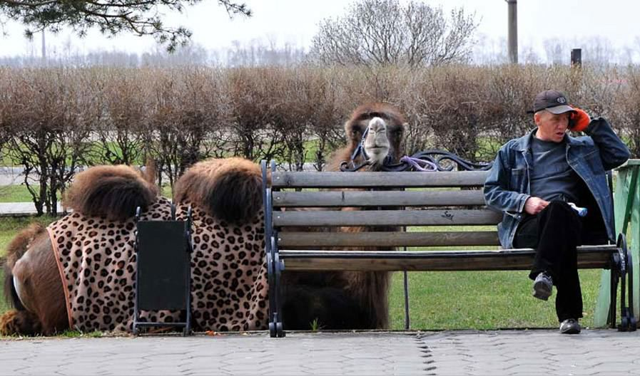

Slide 5
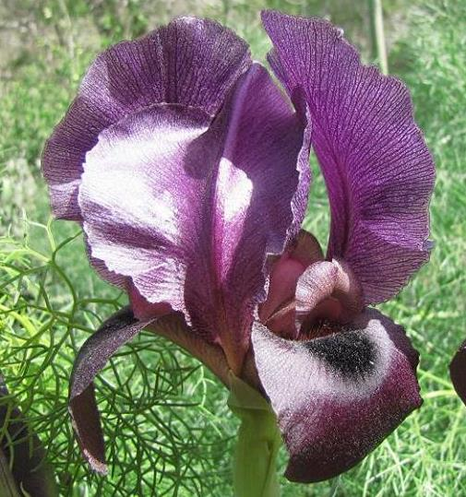
Oncocyclus
3 – 28 inches (8 – 71 cm)
Unbranched
Single bloom
Straight stalk
Narrow foliage
Flower form very diverse
Standards larger than falls
Standards usually domes, rounded or broad oval.
Falls flaring, semi-flaring, mildly recurved, strongly recurved, rolled under, concave,
May have style arms that are protruding outward
Beards are broad diffuse
liner beards are sometimes found
Iris haynei, photo David Shahak of Israel

Slide 6
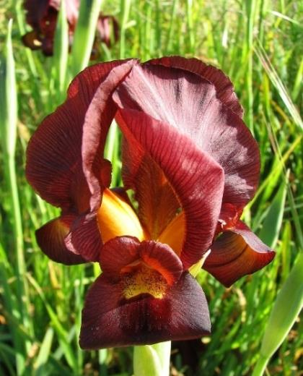
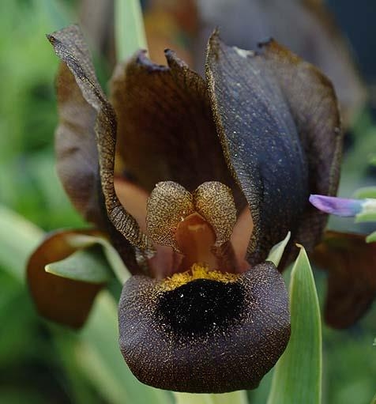
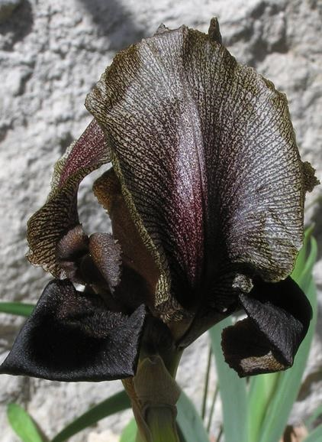
Oncocyclus
I.atropurpurea, Photo B. Strashunski
Iris bostrensis, photo O. Fragman-Sapir
I. nigricans, R. Photo D.Dominguez

Slide 7
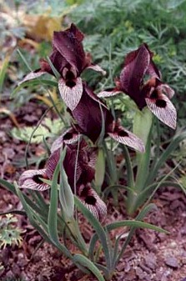
Oncocyclus
The Exception
Exceptions in every class
Iris acutiloba
Iris acutiloba photo Dennis Kramb

Slide 8
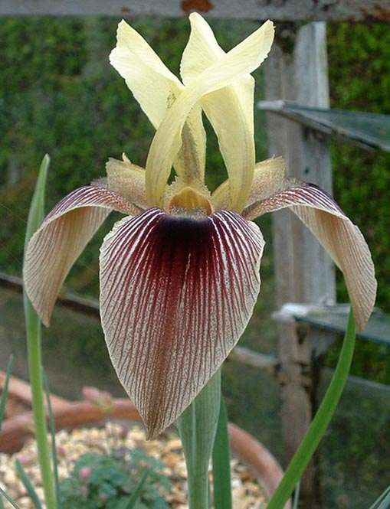
Regelia
Two buds
Slender stem
Tall in proportion to flower size
Flower form narrow
Falls down hanging
Standards pointed and touching
Beards on falls and standards
Small signals
Substance less that with oncos
Flower size small to medium
Foliage narrow tall and erect
Conspicious Veining
Iris afghanica, photo by J. Forrest

Slide 9
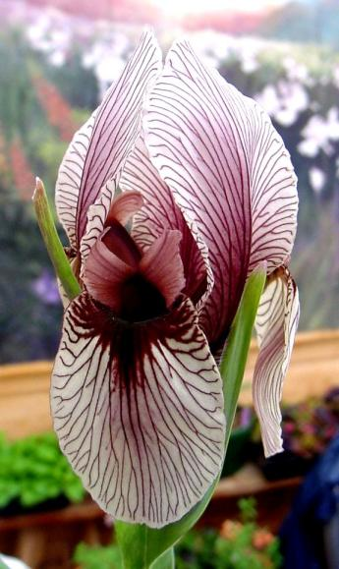
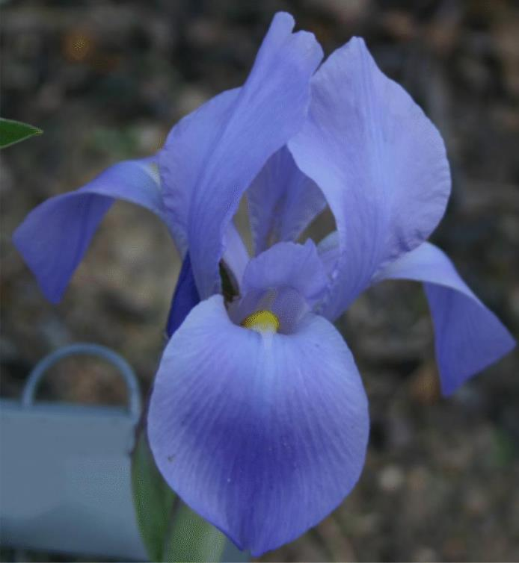
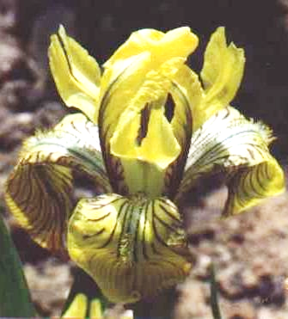
Regelia
Iris hoogiana, Photo Anita Moran
Iris bloudowii photo J. Pirogov
Iris korolkowii, Photo C. Hensler

Slide 10
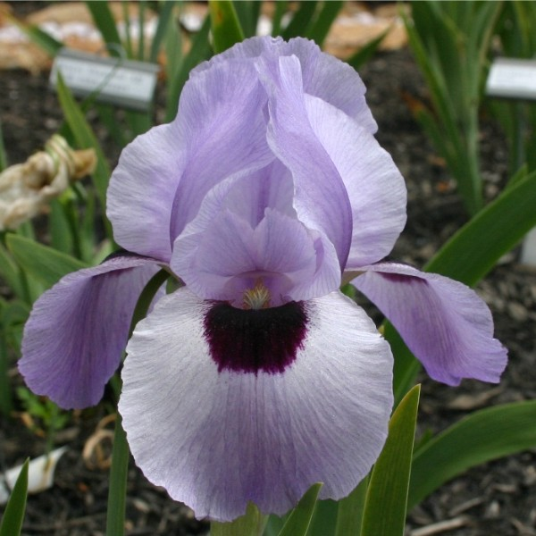
Oncogeliabred
The majority of Arilbred cultivars are in this group
Hybrids involving Oncocyclus, Regelia, any bearded irises
Classification Based on Aril content
OGB + more than ½ aril content
OGB Half Aril content
OGB – Less than half Aril content more than ¼
'Persian Padishah' OGB+ photo A. Moran
Persian Padishah OGB+ photo by Anita Moran

Slide 11
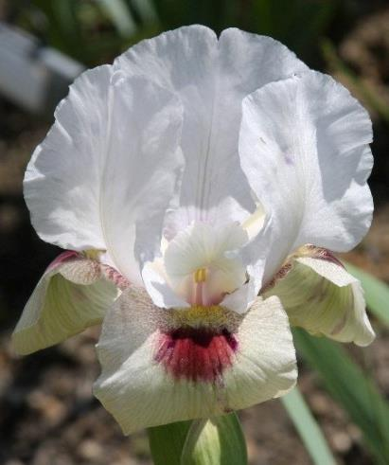
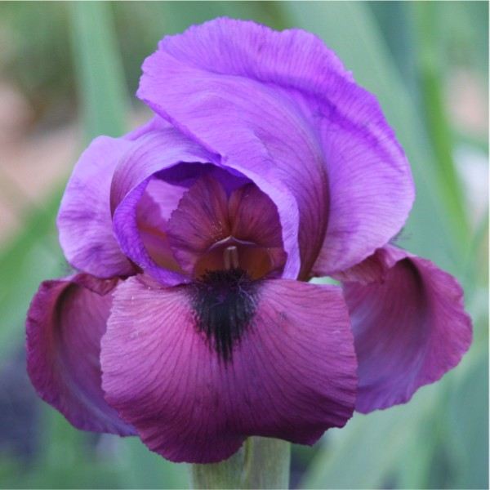
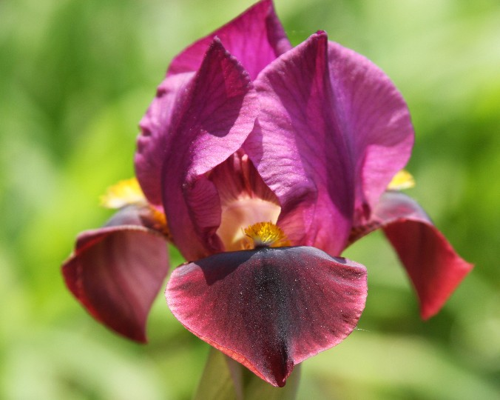
'Masada's Glory' OGB+ photo A. Moran
'Kalifa's Robe’ OGB Phota A. Moran
‘Raven’s Heart’ OGB- Phota A. Moran

Slide 12
Bearded Irises
Cultivars and Species

Slide 13
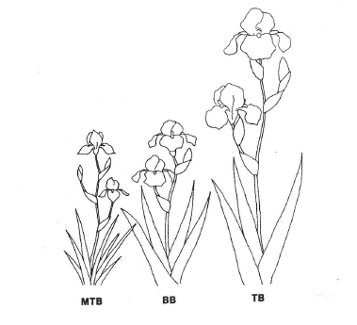
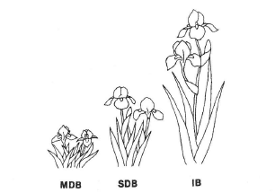
Bearded Irises Height
Handbook For Judges and Show Officials
Bearded Illustration - p 1

Slide 14
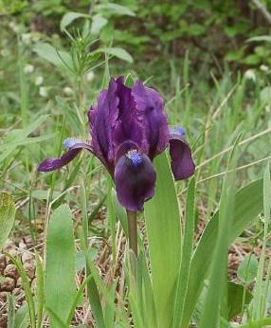
Miniature Dwarf Bearded
Up to 8”
Flower Size
Min – W+H = 1.6”
Max – W+H = 3”
Usually Unbranched
Can be single bloom
Leaves errect below the bloom
Earliest to bloom
Iris pumila, photo T. Fietz

Slide 15
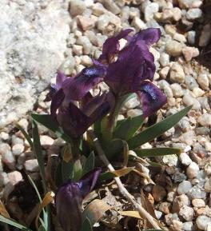
Miniature Dwarf Bearded
Iris pumila
The most important Species behind
modern MDBs
4” to 6”
White, yellow, blue, purple,
violet, or bicolored
flowers,
With yellow or blue beards
Stems unbranched
Sunny, well drained soil
Zone 2-8

Slide 16
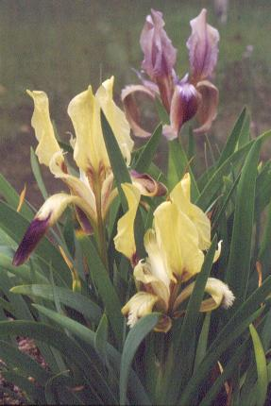
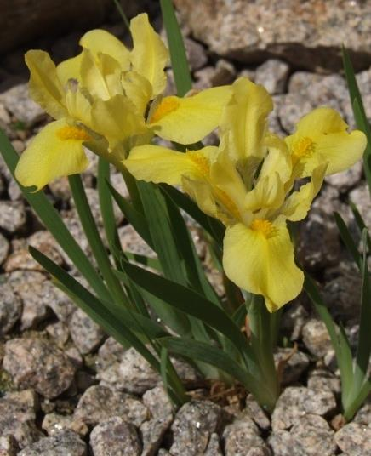
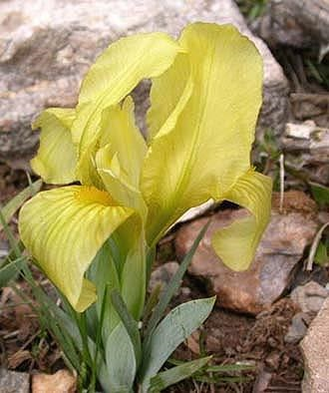
Miniature Dwarf Bearded
Iris attica, photo Harald Mathes
Iris humilis, Photo P. Bohnert
Iris lutescens, Photo A. Moran

Slide 17
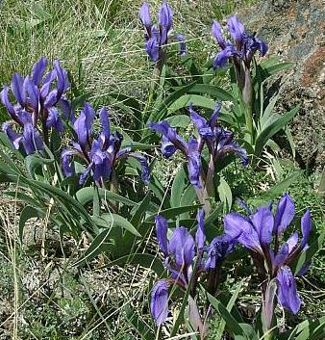
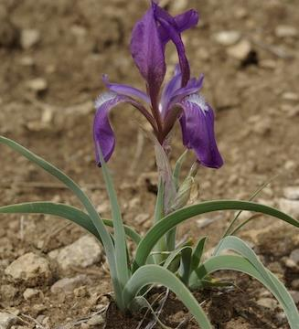
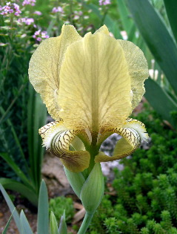
Miniature Dwarf Bearded
Iris glaucescens, photo Y. Pirogov
Iris timofejewii, Photo Ramazan
Iris schachtii, photo J. Murrain

Slide 18
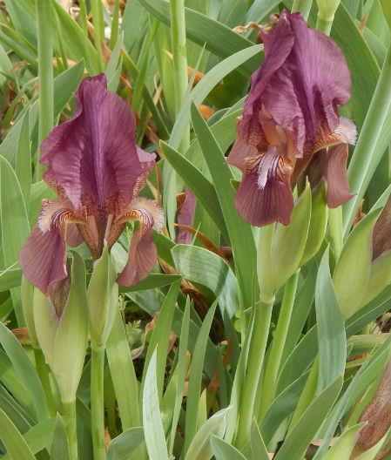
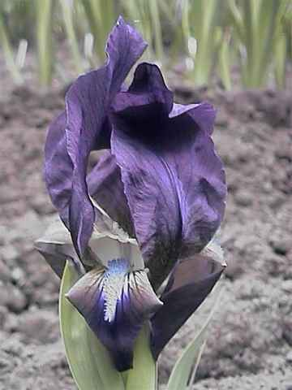
Miniature Dwarf Bearded
Iris reichenbachii, Photo Tom Waters
Iris suaveolens, photo Will Plotner

Slide 19
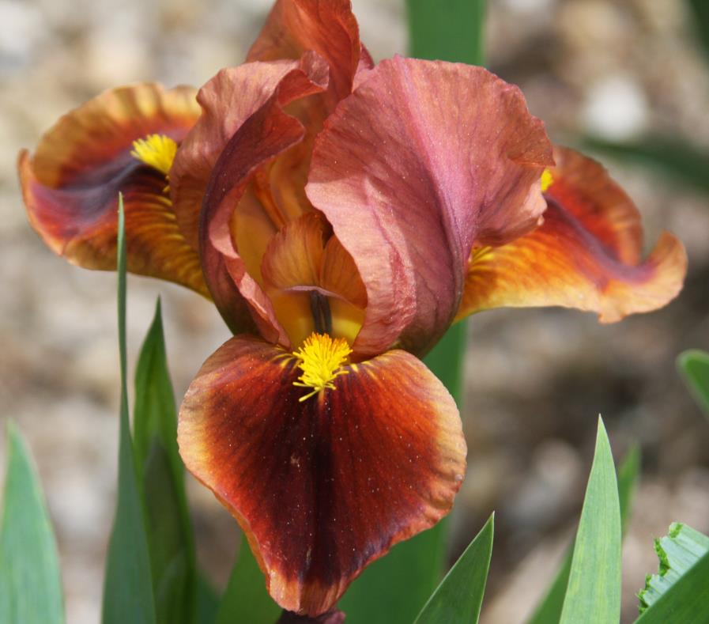
Miniature Dwarf Bearded
Up to 8”
Small Flower Size
Branched or unbranched
1-3 blooms
Leaves errect below the bloom
Earliest to bloom
From MDB Species, SDB, MTB and other crosses
Wide range of color and patterns
‘Candy Dragon’, photo Anita Moran

Slide 20
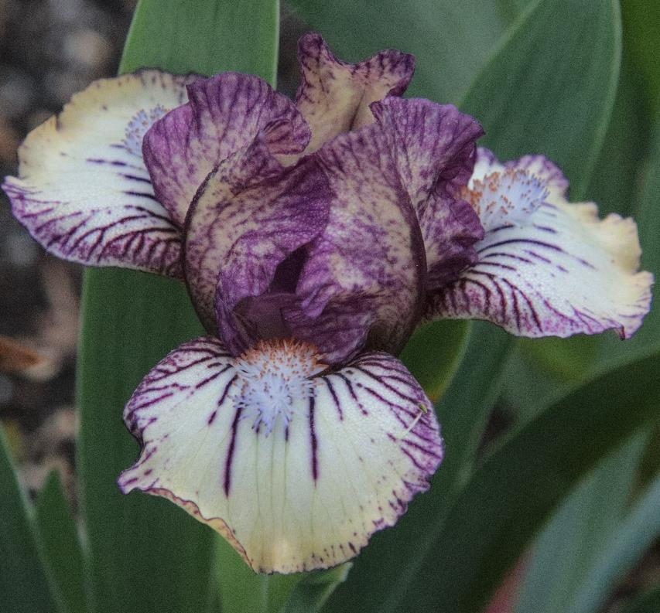
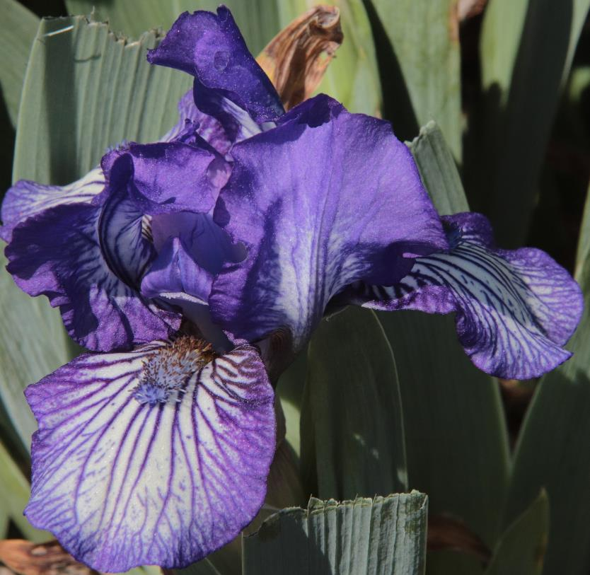
Miniature Dwarf Bearded
‘Bettlejuice’, photo Anita Moran
‘Dinky Circus’, photo Anita Moran

Slide 21
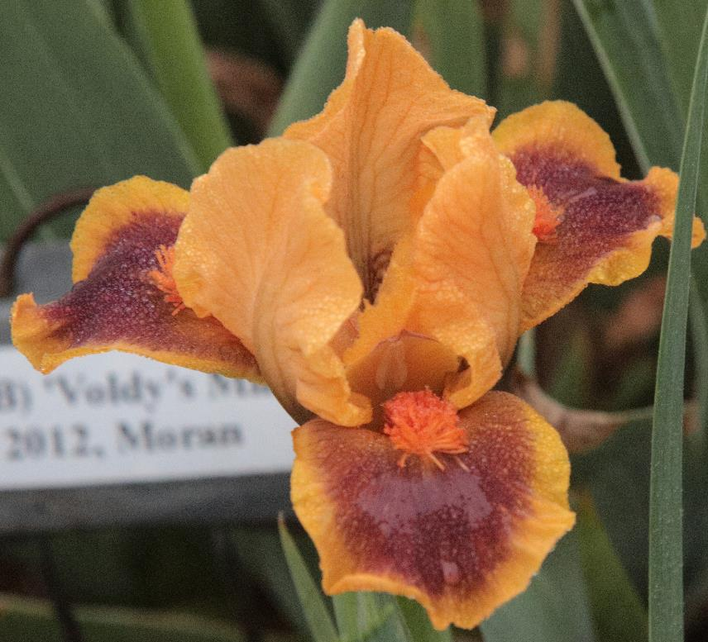
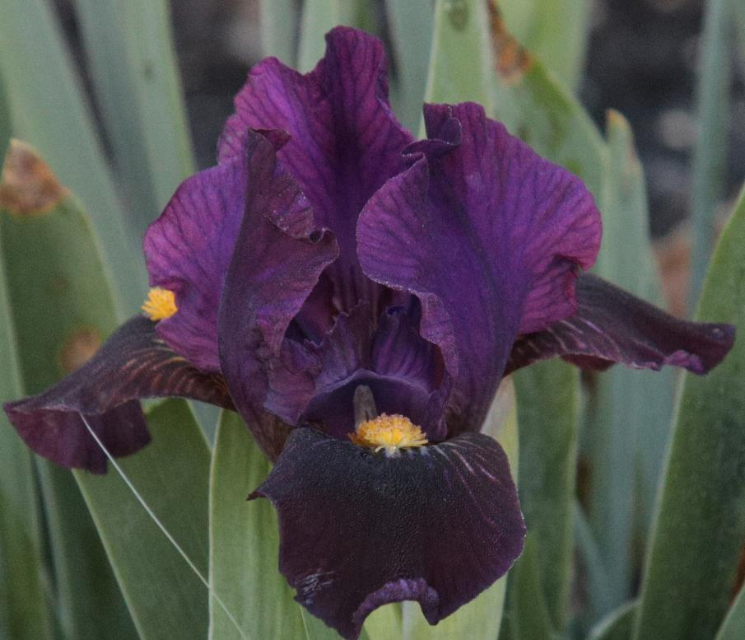
Miniature Dwarf Bearded
‘Icon’, photo Anita Moran
‘India Ink’, photo Anita Moran

Slide 22
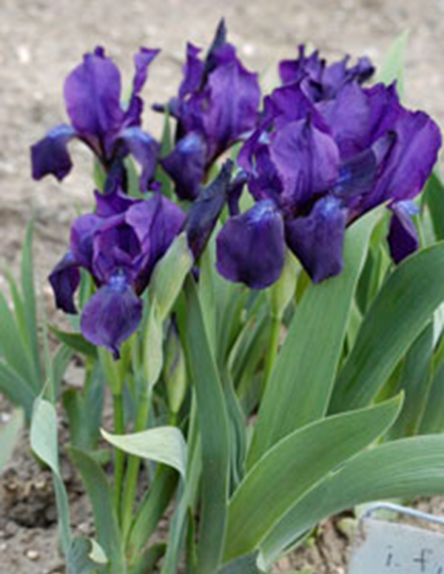
Standard Dwarf Bearded
Species
6” – 20”
Variable flower size
Variable bud count
2+ terminal buds
Branched or Not
Blooms mid MDB season to beginning of IB, BB season
Species, BB, TB, MTB,
Iris furcate photo Lowell Baumunk

Slide 23
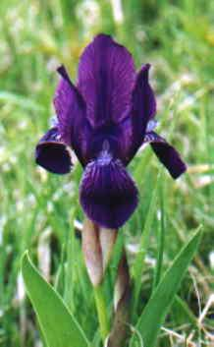
Standard Dwarf Bearded
Iris aphylla
6” to 18”
Can be MDB, SDB, MTB, IB in height,
and flower
Stalk may have many branches
Zone 3-8
Forest Steppes Central and Eastern Europe in Sand and limestone
Endangered in Wild
Iris aphylla, photo by J. Pirogov

Slide 24
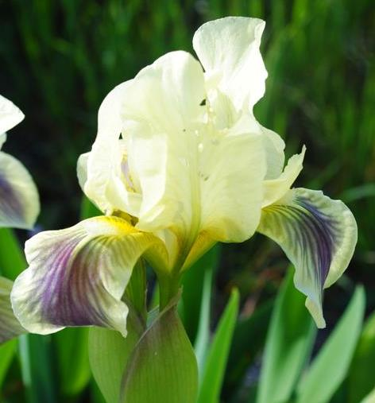
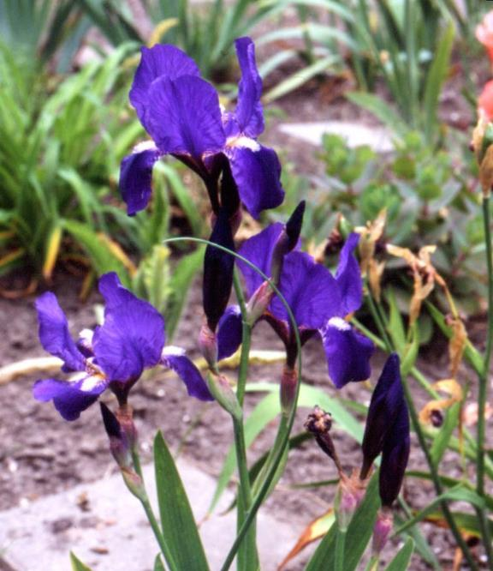
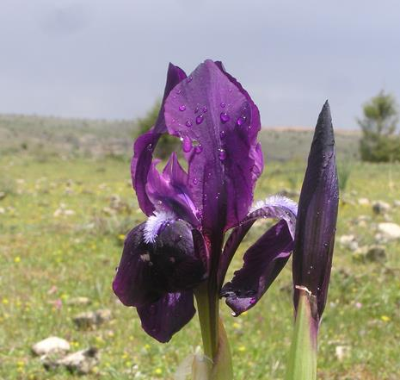
Standard Dwarf Bearded
Iris bicapitata, Photo P. Toolan
Iris croatica, photo H. Mathes
Iris subbiflora, Photo R. Diez Dominguez

Slide 25
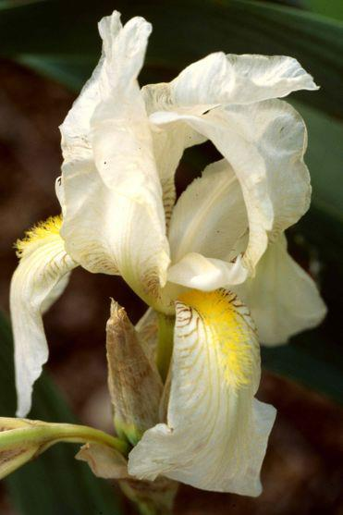
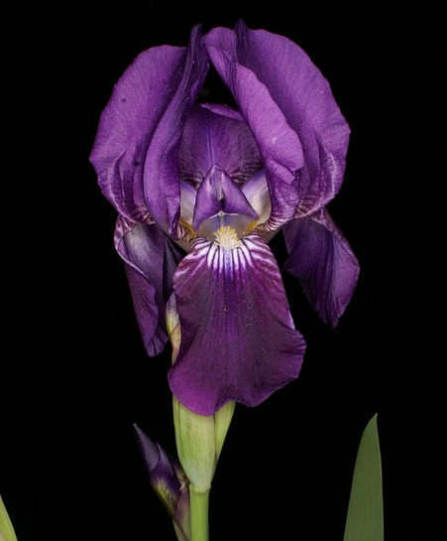
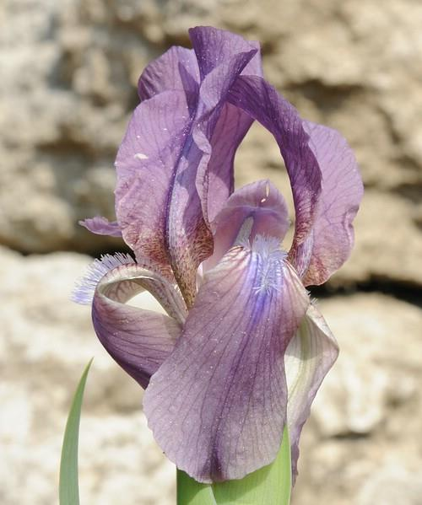
Standard Dwarf Bearded
Iris sabina photo G. Raschun
Iris taochia photo G. Raschun
Iris orjenii, Photo Botanischer Garten

Slide 26
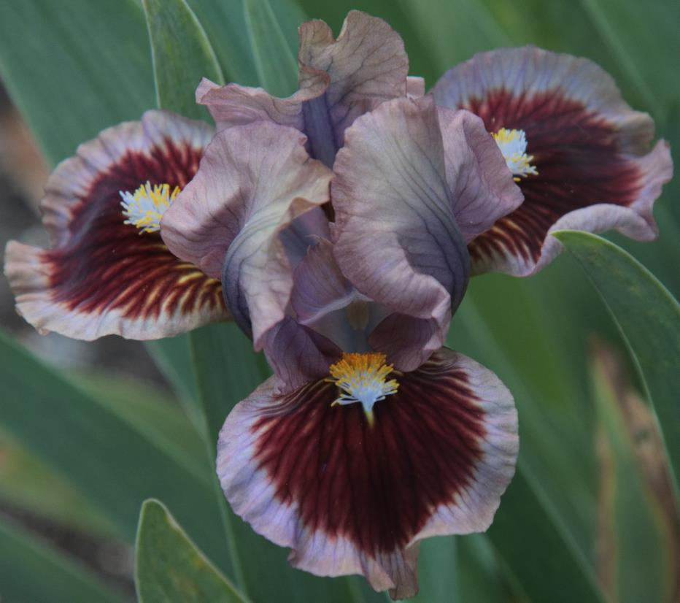
Standard Dwarf Bearded
8” - 16””
Flower size 3.4” – 6.8” W + H
Branched or unbranched
2-5 blooms
Leaves errect below the bloom
From MDB, Species, SDB, MTB,
Wide range of color and patterns
‘Voldy’s Mink’, photo Anita Moran

Slide 27
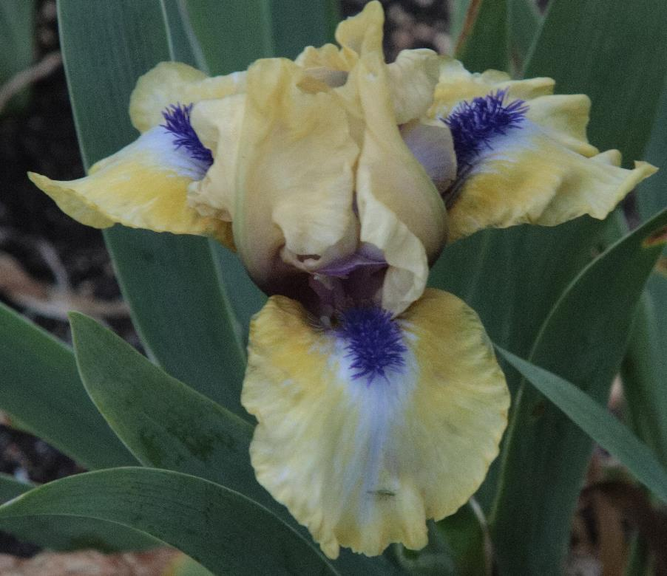
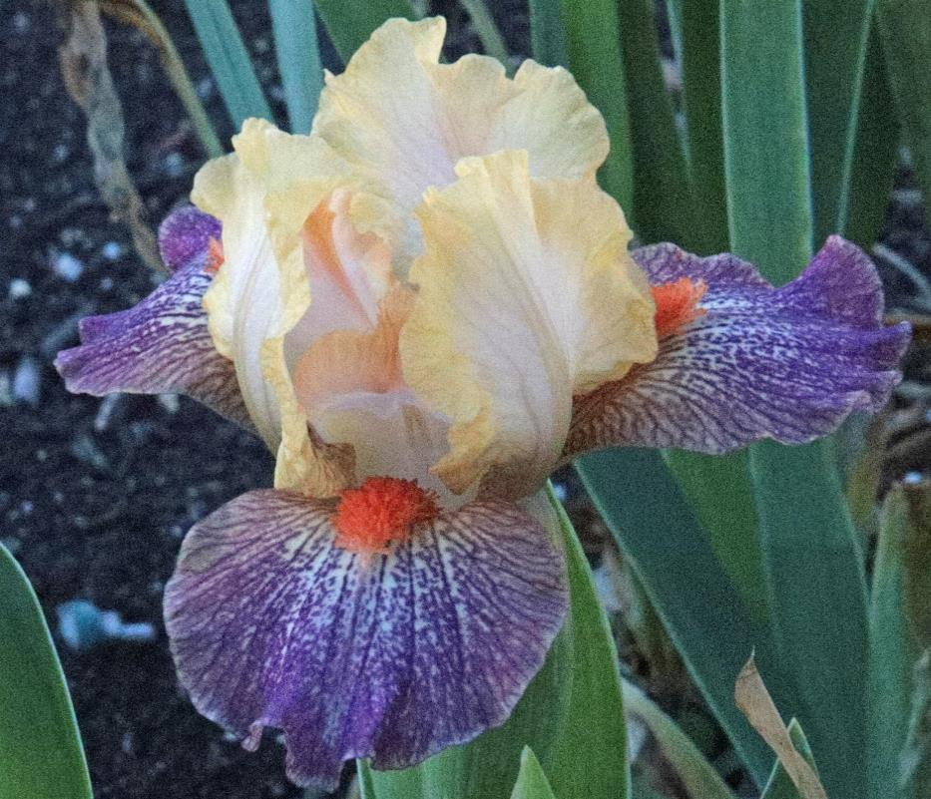
Standard Dwarf Bearded
‘Blue Eyes Girl’, photo Anita Moran
‘Dirty Blond’, photo Anita Moran

Slide 28
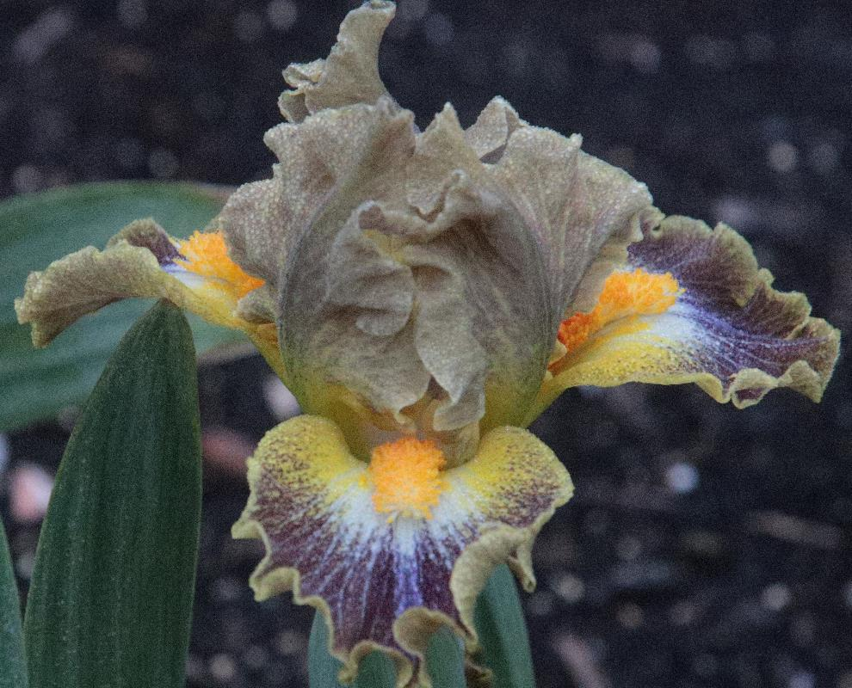
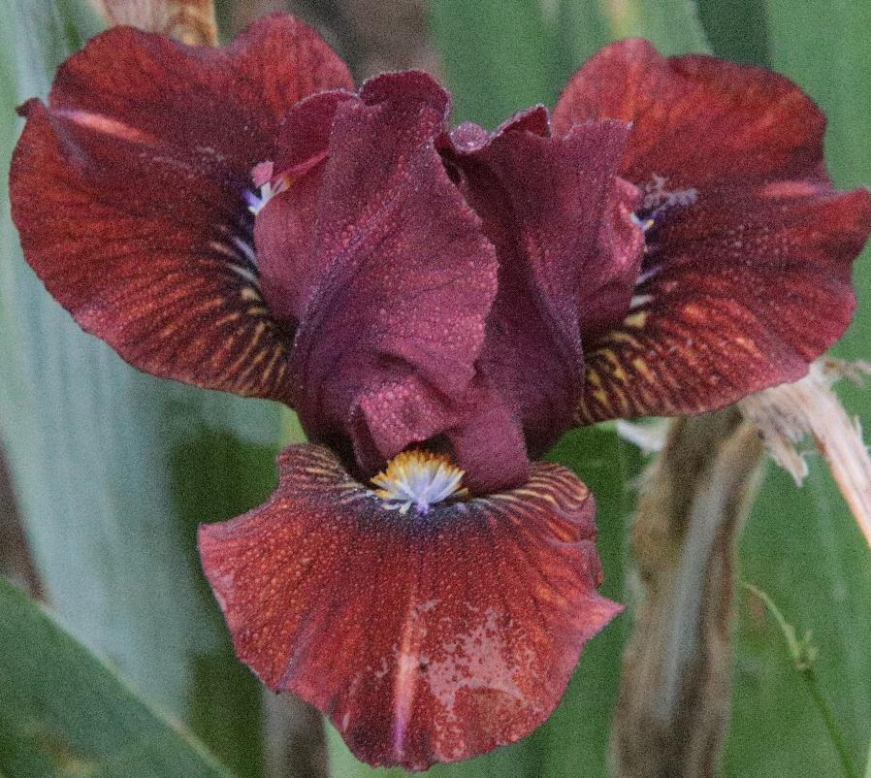
Standard Dwarf Bearded
‘Flying Monkey’, photo Anita Moran
‘Orange Arc’, photo Anita Moran

Slide 29
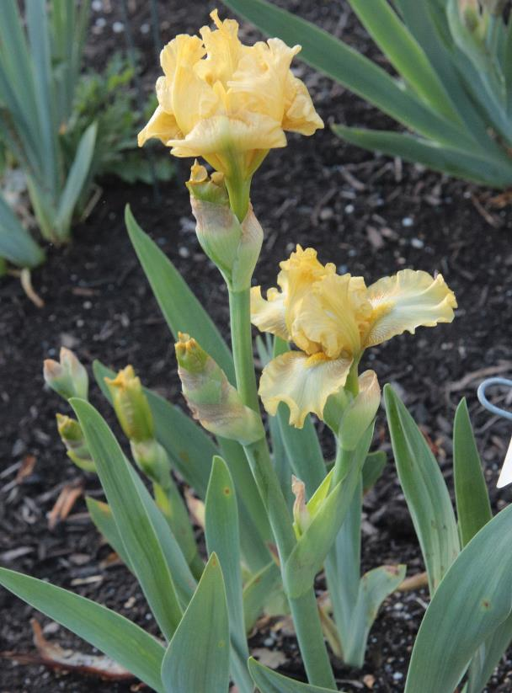
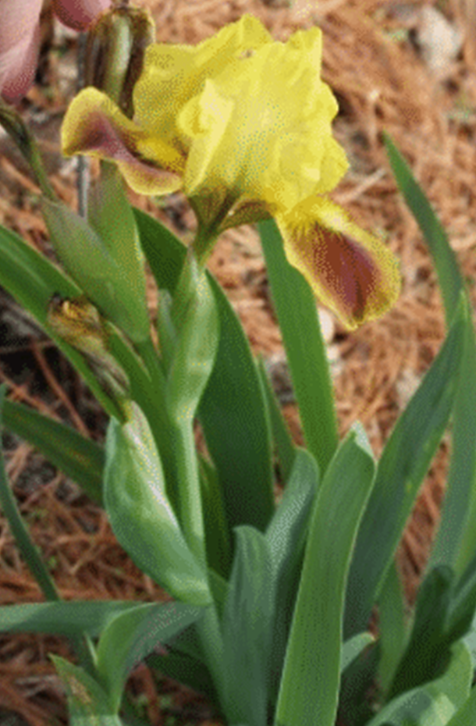
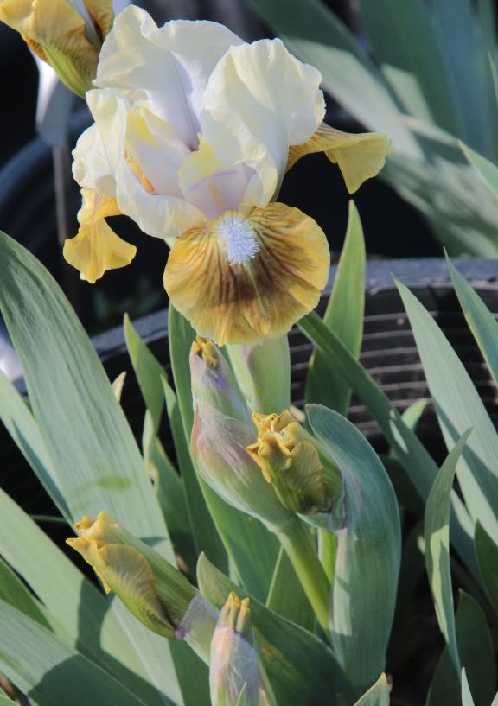
Standard Dwarf Bearded
‘Nibble’, photo Anita Moran
Moran Seedling STM9,
photo Anita Moran
Moran Seedling 11STM9gp08, photo Anita Moran

Slide 30
Intermediate Bearded
Iris aphylla
6” to 18”
Can be MDB, SDB, MTB, IB in height,
and flower
Stalk may have many branches
Zone 3-8
Forest Steppes Central and Eastern Europe in Sand and limestone
Endangered in Wild
Iris aphylla, photo by J. Pirogov

Slide 31
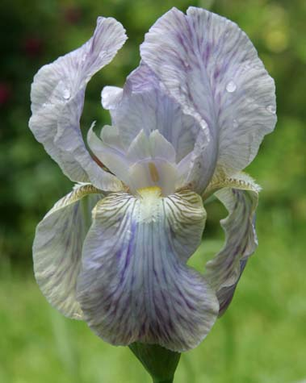
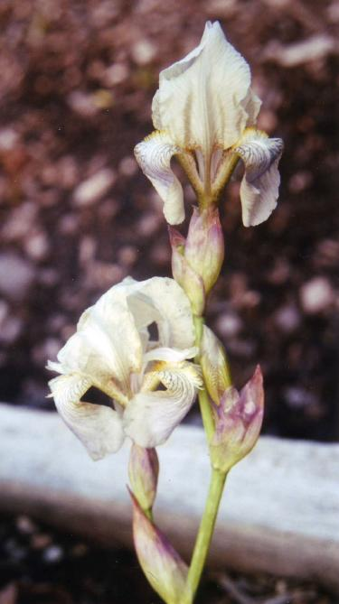
Intermediate Bearded
Iris purpureobractea, photo J. Clark
Iris junonia, photo Ken Walker

Slide 32
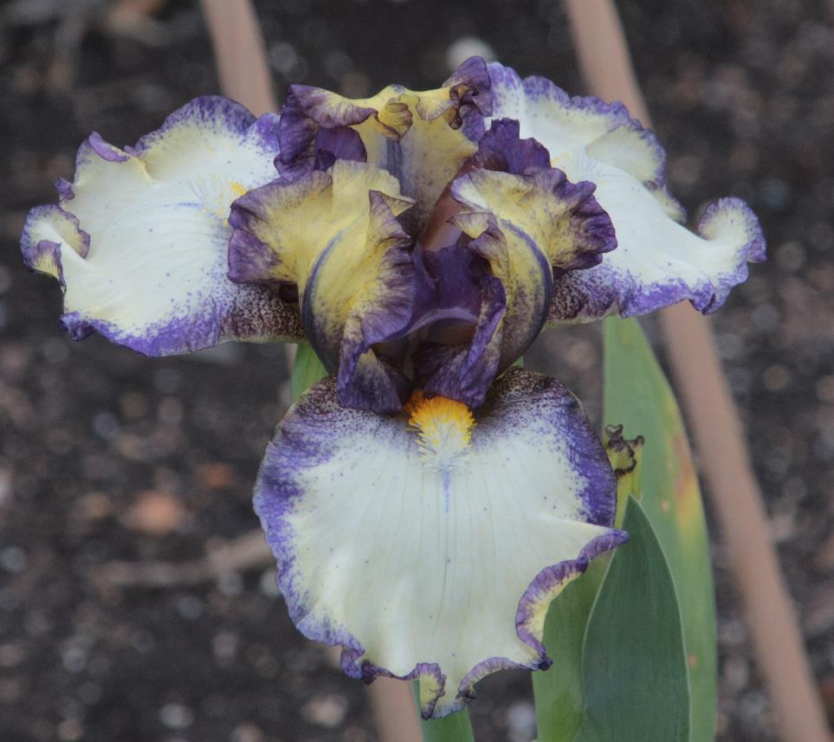
Intermediate Bearded
16” to 27.5”
Flower size 3.5” – 5” Wide
Branched variable
Bud count variable
Can have both SDB and TB form
Usually from cross between MDB or SDB and TB or BB
Wide range of color and patterns
Great vigor comparable
Used to be sterile more fertile now due to use of I. aphylla
‘Nickle’, photo Anita Moran

Slide 33


Intermediate Bearded
‘Black Comedy’, photo Anita Moran
‘Airy Fairy Flower’, photo Anita Moran

Slide 34


Intermediate Bearded
‘Bahama Blue’, photo Anita Moran
‘Bottled Sunshine’, photo Anita Moran

Slide 35

Border Bearded
16” to 27.5”
Flower size < 5” wide
Stem thinner than IB
At least 2 branches
At least 7 buds
Usually from short TB
‘Dark Wonder’, photo Anita Moran

Slide 36


Border Bearded
‘Frosty Spirit’, photo Anita Moran
‘Sorbet Swirl’, photo Anita Moran

Slide 37


Border Bearded
‘Little Rosie’, photo Anita Moran
‘Broken Border’, photo Anita Moran

Slide 38
Miniature Tall Bearded
Iris aphylla
6” to 18”
Can be MDB, SDB, MTB, IB in height,
and flower
Stalk may have many branches
Zone 3-8
Forest Steppes Central and Eastern Europe in Sand and limestone
Endangered in Wild
Used by Ben Hager to produce Tetraploid MTB
Iris aphylla, photo by J. Pirogov

Slide 39



Miniature Tall Bearded
Iris variegata var. pontica, photo Anita Moran
Iris variegata var. reginae, photo Anita Moran
Iris variegata, Photo J. Baumfalk

Slide 40

Miniature Tall Bearded
Miniature Tall Bearded
16” to 27.5” High 22” preferred
Flower < 6” W x H
Slender stalk 1/8- 3/8” tip to 5/8” near base
Two branch + terminal
7 buds at least
Normally diploid
Tetraploid with crosses with I. Aphylla
‘Frosted Velvet’, photo Anita Moran

Slide 41


Miniature Tall Bearded
‘Frosted Velvet’, photo Anita Moran
'Bumblebee Deelite', photo Anita Moran

Slide 42


Miniature Tall Bearded
‘Plinko’, photo Anita Moran
‘Frilly Molly’, photo by Anita Moran

Slide 43

Tall Bearded
Species
16” – 35”
Can bloom earlier than other bearded
7+ bud count
Branched
Iris germanica, photo Ken Walker

Slide 44



Tall Bearded
Iris albertii, photo L. Baumunk
Iris germanica, Photo P. Bohnert
Iris pallida, Photo Ken Walker

Slide 45

Tall Bearded
27.5” +
Blooms after Medians
7+ bud count
2+ Branches
Wide Varity of colors and patterns
‘Haunted Heart’, photo Anita Moran

Slide 46


Tall Bearded
‘Top Choice’, photo Anita Moran
‘Steal Your Heart’, photo Anita Moran

Slide 47


Tall Bearded
‘Don’t Doubt Dalton’, photo Anita Moran
‘Dream About You’, photo Anita Moran

Slide 48
Beardless Irises
Japanese
Lousianna
Siberian
Other Beardless Species
Species Crosses

Slide 49


Slide 50

Japanese Iris
Species Iris ensata
24” – 35”
Bloom After Tall Bearded
White, Purple, Reddish Purple
Strong Midrib in leaves
Two terminal buds
1 branch with possible bud
3 to 12 falls with multiple petaloids
Moist when growing dry in cold winter or resting warmer winters
Iris ensata, photo Anita Moran

Slide 51


Japanese Iris – 3 Falls
‘Rose Frappe’, photo Anita Moran
‘Dirigo Pink Milestone’, photo Anita Moran

Slide 52


Japanese Iris – 6 + Falls
‘Center Of Attention’, photo Anita Moran
‘Koto Harp Strings’, photo Chad Harris

Slide 53


Japanese Iris – 9 + Falls
‘Amethyst’s Sister’, photo Chad Harris
‘Lion King’, photo Chad Harris

Slide 54

Louisiana Iris
Species
18” – 31”
Bloom with Tall Bearded
Colors red, copper, orangish, or Flowers 4”-5”
Two terminal buds
Branched with possible buds
Moist wetland areas
Can be grown in partial shade
Iris fulva, photo by Dennis Kramb

Slide 55


Louisiana Iris
Iris giganticaerulea, Photo R. Barton
Iris nelsonii, photo Patrick O'Connor

Slide 56


Louisiana Iris
Iris brevicaulis, photo by G. Lupinetti, and D. Kramb

Slide 57

Louisiana Iris
10” – 50”
Leaves vary in width and length
Blooms with Tall Bearded
Crinkling or pleating of the foliage normal on bloom stalk
Stalks straight, curved, or zigzag
6+ Buds per stalk
Flowers has many forms
‘Heartbreak Warfare’, photo Anita Moran

Slide 58


Louisiana Iris
‘Clyde Redmond’, photo Anita Moran
‘Improbable Plot’, photo Anita Moran

Slide 59


Louisiana Iris
‘Jean Betzer’, photo Anita Moran
‘Kakadu Sunset’, photo Anita Moran

Slide 60

Siberian Iris
Species
Made up of 3 main species
I. siberica, I. typhifolia and I. sanguinea
16” to 40”
Blooms late Tall Bearded season
Can extend into Japanese Iris season
Iris sibirica, Photo Ken Walker

Slide 61


Siberian Iris
Iris sanguinea, photo by L. Bernler
Iris typhifolia, photo E. Kondratas

Slide 62

Siberian Iris
Cultivars
7” to 48”
Two branches + terminal usually max found
2 to 3 buds per socket
Foliage from < 1/2” to ¾”
No preferred size or form
Diploid naturally occurring
Tetraploid colchicine drug induced
‘Shaker’s Prayer’ Photo Anita Moran

Slide 63


Siberian Iris – Diploid
Only Siberian Dykes Medal Winner
‘Swan’s In Flight’ Photo Anita Moran
‘Swan’s In Flight’ Photo Chad Harris

Slide 64


Siberian Iris – Diploid
‘Hot Hot Hot’ Photo Anita Moran
‘Deep In My Heart’ Photo Ensata Gardens

Slide 65


Siberian Iris – Tetraploid
‘Topaz Ruffles' Photo Carol Warner
'Am I Amethyst' Photo Ensata Gardens

Slide 66

Spuria Iris
Species
Two main groups including dwarf species
8” to 60”
Zone 4-9
Like rich alkaline soil like bearded
Leaves erect, slender, sword-shaped
1-2 branches
Scented flowers
Iris spuria, photo Peter Bohnert

Slide 67



Spuria Iris
Iris orientalis, Photo Ken Walker
Iris crocea, Photo Peter Bohnert
Iris graminea, photo L. Bernler

Slide 68

Spuria Iris
Cultivars
20” – 36”
4 – 7 buds varies by climate
2 branches
Prefers same conditions as Tall Bearded
Blooms above the foliage
Multicolored and combinations
‘Osage River' Photo Anita Moran

Slide 69


Spuria Iris
‘Wapiti Citi' Photo Anita Moran
‘Ibex Ibis' Photo Anita Moran

Slide 70


Spuria Iris
‘Eleanor Hill' Photo Anita Moran
‘Dawn Candle' Photo Anita Moran

Slide 71

Laevigatae Iris
Species
Includes the following species: prismatica, laevigata, maackii, mzchetica, pseudocorus, versicolor, virginica
18” to 36”
I. pseudocorus invasive illegal in most states
Wetland irises
Can grow in garden soil
Blooms from early TB to JI
Iris laevigata, photo L. Bernler

Slide 72



Laevigatae Iris
Iris prismatica, Photo Ken Walker
Iris maackii, Photo Ken Walker
Iris pseudacorus, photo y J. Murrain

Slide 73



Laevigatae Iris - Iris versicolor
Native Species US Northern Blue Flag Iris
18” – 30”
2 – 5 Branches
2 - 5 buds per branch
Require 6 weeks of cold treatment
Can be grown in pond or garden beds
Likes rich moist soil best in s hallow water
Iris vedrsicolor Photo Anita Moran

Slide 74



Laevigatae Iris - Iris virginica
Native Species US Southern Blue Flag Iris
8” – 36”
Unbranched or with 1
1-4 buds per stalk
Can be grown in pond or moist garden beds
Zone 6 – 10
Needs rich moist soil best in shallow water
Iris virginica, Photo by Will Plotner, Anita Moran

Slide 75
Other Species Iris

Slide 76

Species Iris Chrysographes
Sino-Siberian
Species
The Black Iris
Oriental species not European
Sino-Siberian = Siberian from China
Most 6” – 18” I. delavayi up to 48”
Grass like foliage
Require more care than Siberians
Less tolerant of poor soils, drought, and cold weather
Iris Chrysographes, Photo A. Moran

Slide 77



Species Iris Chrysographes
Sino-Siberian
Iris delavayi, Photo Todd Boland
Iris forrestii, photo K. Walker
Iris bulleyana, photo K. Walker

Slide 78


Species Iris Chrysographes
Sino-Siberian
Iris dykesii, photo Will Plotner
Iris wilsonii, photo K. Walker

Slide 79

Species Iris - Crested
Species
Includes the following species: cristata, confusa, gracilipes, japonica, lacustris, milesii, tectorum, wattii
Dwarf and taller species
Can tolerate partial shade
Can tolerate moist conditions but usually not wet
Forest debris to stone in outcrops
1-20+ buds per stalk
Iris cristata, photo by G. Tepper
3”-5”, 1-2 buds, part shade to not heavy shade, forest litter, Zone 3-8, US Native plant

Slide 80


Species Iris - Crested
Iris gracilipes, photo by Ken Walker
4”-6”, 1-2 buds, part shade forest side rocky shore, pond side, Zone 5-8,
Iris tectorum, photo D. Kramb
10”-14”, 1-3 buds per socket, branched, part shade and sun, Zone 6-11, Japanese Roof Iris

Slide 81


Species Iris - Crested
Iris lacustris, photo Sean Zera
3”-5”, 1-2 buds, part shade to not heavy shade, forest litter, Zone 3-8, US Native plant
Iris japonica, Lewis and Adele Lawyer
18”-31”, 5-12 branches, 3-5 buds per branch, part shade, wet grassland hillsides, Zone 6-10,

Slide 82


Species Iris - Crested
Iris milesii, photo by Ken Walker
12”-30”, 2-4 branches, 3-4 buds per branch, part shade, moist not wet, Zone 3-8,
Iris wattii, Photo Ken Walker
12”-35”, 5-7 branches, 3-5 buds per branch, part shade, forest edges wetlands, Zone 7-10,

Slide 83

Species Iris - Chinensis
Species
Includes the following species: speculatrix, henryi, koreana, minutaurea, odaesanensis
2”-8”
Will tolerate partial shade
Can tolerate moist conditions but usually not wet
Forest debris to stone in outcrops
1-4 buds per stalk
Iris koreana, photo D. Kramb
8”-14”, un branched, 2 buds, part shade, moist not wet, Zone 4-8,

Slide 84


Species Iris - Chinenses
Iris speculatrix, photo J. Murrain
8”-10”, un branched, 2-3 buds, part shade, forest margin, Zone 6-10,
Iris odaesanensis, photo by D. Kramb
2”-6”, unbranched, 1 buds, part shade, grassy hill, Zone 5-8,

Slide 85



Species Iris - Foetidissimae
‘The Stinking Iris’
12”- 24”
Will tolerate partial shade
Moist well drained soil
Grown for seed in colors of red occasionally orange, yellow and white
1-4 buds per stalk
Zone 4-8

Slide 86

Species Iris -Tripetalae
Species
Includes the following species: hookeri, setosa, tridentata
2”-30”
Will tolerate partial shade
Can tolerate moist conditions but usually not wet
Forest debris to stone in outcrops
1-4 buds per stalk
Iris hookeri, photo by Ken Walker
8”-10”, unbranched or branched, 1-3 buds, part shade, forest margin, sea spray Zone 8-11,

Slide 87


Species Iris -Tripetalae
Iris setosa, photo Ken Walker
6”-35”, 1-2 branches, 1-3 buds per branch, part shade, forest margin, Zone 3-8, ‘Artic Iris’
Iris tridentata, photo by D. Kramb
12”-28”, 3 branches, 5-7 buds per stalk, bog plant, Zone 5-8, US Native SE

Slide 88

Species Iris Lactea
Species
2”-16”
Bloom late Summer with/after JI
Will tolerate partial shade
Can tolerate many conditions
From Asia
2-4 buds per stalk
Zone 3 -9

Slide 89

Species Iris verna
Species
3”-5”
Sun to partial shade
Can tolerate many conditions
1-2 buds per stalk
Zone 5 -9
Native to USA

Slide 90

Species - Dichotoma
Species
‘Vesper iris’
6”-14”
4-5 branches
Sun to partial shade
Can tolerate many conditions
4-5 buds per stalk
Zone 6-10
Bloom mid-May to mid-June
Native to USA

Slide 91

Species Iris - Unguicularis
Species
‘Vesper iris’
4”-8” stalk leaves 18” – 38”
No branches
Dry poor soil
Sun to part shade
1-2 buds per stalk
Zone 8-10
Bloom late fall to late winter

Slide 92

Species Dietes grandiflora
Species
‘Fortnight lily’
African Iris
12”-32” stalk
1-3 branches
Dry poor soil
Sun to part shade
4-7 buds per stalk
Zone 8-10
Bloom late spring to late fall

Slide 93
Naturally Occurring Species Crosses

Slide 94


Slide 95

Species Cross - x fulvala
fulva x I. brevicaulis
Naturally occurring and manmade
18” – 31”
Bloom with Tall Bearded
Colors vary
Flowers 4”-5”
Two terminal buds
Branched with possible buds
Prefers ponds and waterway
Can be grown in partial shade
Photo Unknown sorce SIGNA

Slide 96

Species Cross x hollandica
Iris hollandica x I. xiphium
Dutch Iris
Naturally occuring and Manmade
24” stalk
No branches
Dry well drained
Full Sun
1 – 2 buds per stalk
Zone 2-9
Deer Resistant
Bloom May-June
Photos PotEmUp (Dave’s Garden)

Slide 97

Species Cross x robusta
Iris virginica x I. versicolor
Naturally occurring and manmade
32” stalk
2 – 3 branches
3 buds per branch
Wet soil
Full sun
Zone 4-9
Bloom May-June
Photos ‘Wooly Bully’ Photo Anita Moran

Slide 98

Species Cross Iris sambucina
Iris pallida x I.variegata
Occurs Naturally when in same area
8” - 31” stalk
1-2 branches
1-2 buds per branch + terminal
Dry well drained
Sun to part shade
Zone 3-8
Bloom with Tall Bearded
Photos Iris sambucina, Lucia Cortopassi

Slide 99
Manmade
Species Crosses

Slide 100


Slide 101
Hybridized Species Crosses

Slide 102




Species Cross Pseaudata
Iris pseudacorus X Iris Ensata
Usually infertile
12” – 36” + stalk
3 – 4 branches
10 – 15 buds per stalk
Moist fertile soil
Full sun can take some shade
Zone 4-9
Bloom May-June
Photos Anita Moran
Furui Shiro
Roryu
Yasha
Yukiyanagi

Slide 103

Species Cross Cal-Sib
Pacific Coast Iris x I. siberica
20” – 30”
Semi-Evergreen
1-3 branches
Rich fertile soil
Sun to part shade
3-6 buds per stalk
Zone 7-9
Bloom Late May - June
Photos Cascadia Iris Gardens
Yukiyanagi

Slide 104

Species Cross Versata
Iris versicolor X I. ensata
22” – 36” stalk
2+ branches
Wet fertile soil dry winter
Sun to part shade
3- 6 buds per stalk
Zone 4-8
Bloom May-June
Photos Will Plotner
'Lavender Bleach'

Slide 105

Species Cross Sibtosa
Iris siberica x I. setosa
Sterile
30” +stalk
1-2 branches
Fertile well drained
Sun to part shade
2-5 buds per stalk
Zone 4-8
Bloom May-June
Photo Anita Moran
Happy Traveler'

Slide 106






Species Cross x norrisii
Iris pardarcanda x I. norrissii
Candy Lily
Short lived, lasting 3-4 years
Self seeding
3’ stalk
Many branches
Sandy well drained pH 5.8-6.8
Full Sun
6-10 buds per branch
Zone 5-10
Bloom May-June
Photos From SIGNA (http://www.signa.org/index.pl?Display+Iris-x-norrisii+15)

Slide 107
Bulbous Irises
Reticulata
Hermodactyloides
Juno
Scorpiris
Nepalensis
Xiphium

Slide 108


Slide 109


Bulb Iris - Reticulata
3”-6” stalk
No branches
Dry well drained
Sun to part shade
1-2 buds per stalk
Zone 2-9
Bloom just before/with MDBs
Photos Anita Moran

Slide 110


Bulb Iris - Xiphium
Spanish Iris
stalk
No branches
Dry well drained
Sun to part shade
1-3 buds per stalk
Zone 2-9
Bloom May-June
Photos Anita Moran

Slide 111


Bulb Iris – Xiphium - Iris Hollandia
Dutch Iris
Most used Florist Iris
24” stalk
1-3 branches
Dry well drained
Sun to part shade
2-4 buds per stalk
Zone 6-9
Bloom May-June
Photos fermi de Sousa

Slide 112






Bulb Iris - Juno
22 + species
6” – 24”stalk
Might be branched in taller species
Dry well drained
Sun
1-3 buds per stalk
Zone 4-8
Bloom March - May
Photos: S. Zera, D. Kramb, K. Walker
I. aucheri
I. bucharica
I. magnifica
I. cycloglossa
I. orchioides
I. vicaria

Slide 113






Bulb Iris - Scorpiris
Related to Junos
24 + Species
10” – 15”stalk
Stony Dry Well Drained
Water well in Spring
Sun
1-3 buds per stalk
Zone 4-8
Bloom March - May
Photos: T. Hall, S. Zera, K. Walker, P. Taggert
I. aitchisonii
I. capnoides
I. galatica
I. nicolai
I. rosenbachiana
I. zenaidae

Slide 114






Bulb Iris – Hermodactyloides
2” – 18”stalk
No branches
Dry well drained
Sun
1-2 buds per stalk
Zone 7-10
Bloom March-April
Photos A. Moran, H. Achilles, H. Akpulat, S. Zera, K. Walker
I. tuberosus
I. pamphylica
I. celikii
I. vartanii
I. winogradowii
I. zagrica

Slide 115



Bulb Iris - Nepalensis
4” – 12” stalk
0-2 branches
Grassy plateaus
Well drained
Sun Summer rain
1-3 buds per stalk
Zone 7-10
Bloom Apr - May
Photos K. Walker, H. Mathes
I. decora
I. collettii
I. barbatula

Slide 116


Slide 117
The End

